Slide 1
Web Development
陳柏宇
2023/11/15
宿舍網路管理小組

Slide 2
Web Development
前端(front end)
Displays pages
Interacts with user
Sends additional requests
後端(back end)
Handles requests (from multiple clients)
Store data
Sends “personalized” responses

Slide 3
What’s Inside a Web Page?
Hyper-Text Markup Language (HTML) 超文本標記語言
Content and structure
Cascading Style Sheet (CSS) 階層式樣式表
Style (e.g., color, font, width, height, etc.)
JavaScript, JS
Interactions
A general-purpose programming language

Slide 4
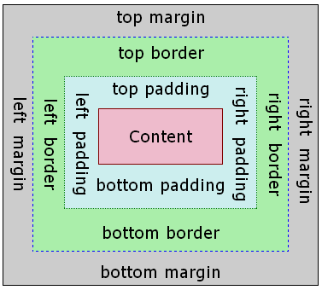
Box Model

Slide 5
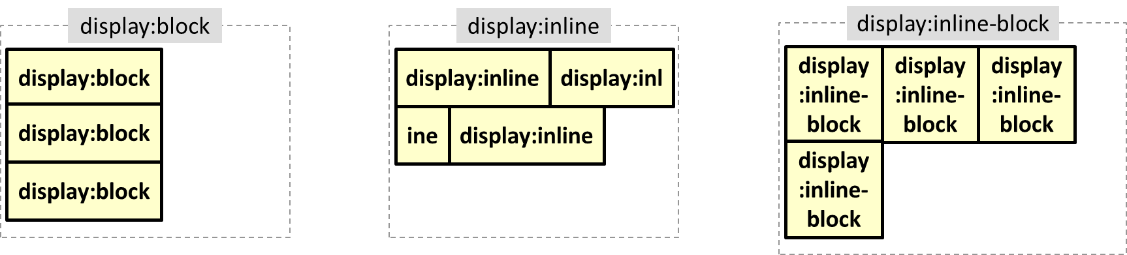
Inline and Block Elements

Slide 6
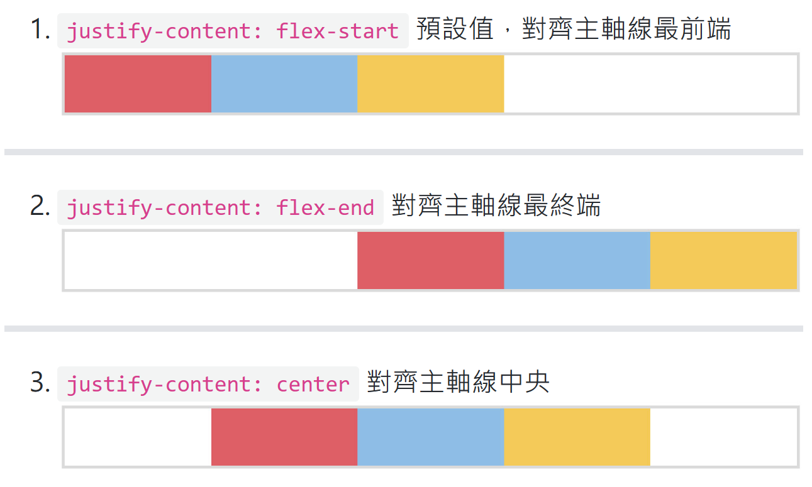
justify-content
justify-content 屬性介紹 - Flex 基礎教學 | W3HexSchool
Notes:
align-items 屬性介紹 - Flex 基礎教學 | W3HexSchool
CSS-CSS Flex. 我排版時最常用也最愛的 css 語法就是… | by Jordan Tseng | JordanTTCDesign | Medium

